Slide 1
Evaluating REACH Funded Projects
Using the REACH Theory of Change

Slide 2
What is Evaluation?
Evaluation is a systematic* method for collecting, analyzing, and using information to answer basic questions about a program
Notes:
* Systematic means that it’s a) planned in advance; b) consistently applied – processes, timelines and rules are created and implemented according to the plan; c) key questions are posed about the program that the evaluation is designed to answer; d) and data collection tools/processes are administered in accordance with the plan and the rules you have set; data collection is designed specifically to answer the questions you posed and nothing more.

Slide 3
Why does the Foundation ask that you include evaluation in your proposal?
Help you tease out why a program works or doesn’t and under what conditions
Establishes an evidence-base that we all want and need
Improves your staff’s practice with patients, clients or consumers
Show how patients, clients or consumers benefit from the program
Helps the Foundation determine which strategies to continue to invest in

Slide 4
Types of Evaluations
Hundreds of different types of evaluations; two most common are:
Implementation evaluation assesses whether a program was implemented as planned, whether the intended target population was reached, and the major challenges and successful strategies associated with program implementation
Outcome evaluation determines whether, and to what extent, the expected changes in health outcomes occur (also called Impact) and whether these changes can be attributed to the program.

Slide 5
How does Evaluation relate to REACH’s Theory of Change?
REACH’s TOC provides guidance on where to focus your evaluation and what to measure
REACH’s evaluation requirements for your grant ask you to focus your evaluation on key elements of the TOC:
Impact (the change in patient health outcomes)
Outcomes (the change in access or quality)
Implementation (aka – Measures of Execution)

Slide 6
What is theory of change?
REACH Healthcare Foundation’s Framework for Investments and Evaluation

Slide 7
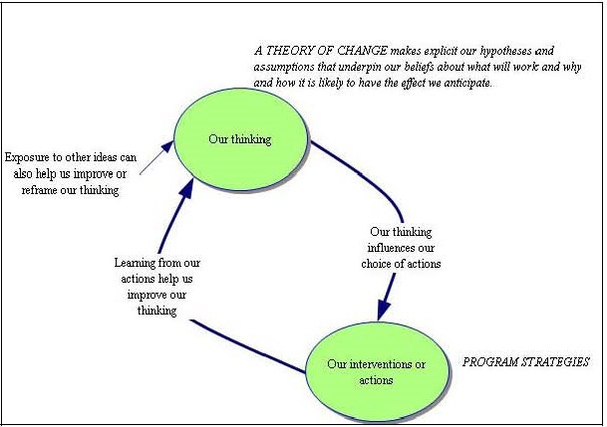
Why we use a Theory of Change Approach

Slide 8
REACH Theory of Change
TOC is the Foundation’s roadmap that visually shows how we think our work will lead to our desired impact
TOC is a representation of the Board approved strategic plan and is informed by published evidence, staff experience, and advice from experts in the field
TOC defines the key building blocks required to bring about a given long-term impact. This set of connected building blocks - impacts, outcomes, strategies, barriers is depicted on a map known as a pathway of change/change framework

Slide 9
Theory of Change
A good TOC tells you. . .
what impacts we seek through our investments in your work
what outcomes are necessary to attain the desired impact, and
which strategies are theorized to bring about positive change in outcomes

Slide 10
Theory of Change
Five components of REACH’s TOC:
Expected Impact of your work
Expected Outcome of your work
Evidence-Based or Promising Strategies
Barriers – What we seek to break through
Indicators (on page 2 of TOC) general description of the kinds of changes we desire in outcomes and impact

Slide 11
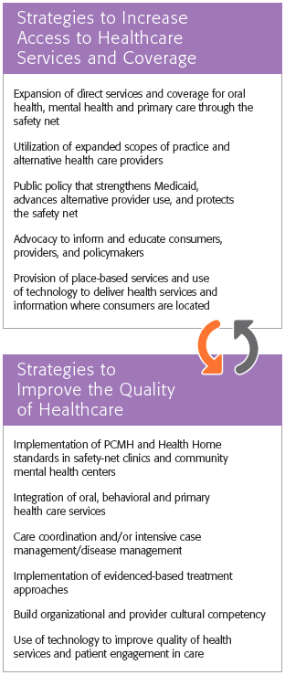
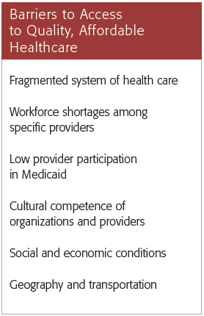
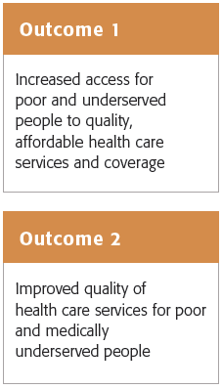
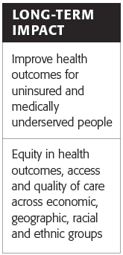

Slide 12
Examples of Theory of Change
(From Simple to the Absurdly Complex)

Slide 13
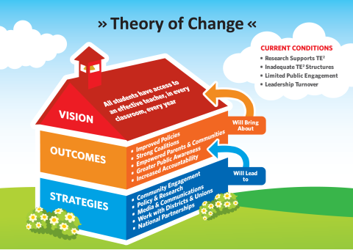
Communities for Teaching Excellence

Slide 14
Legacy LA
Empowers youth to become leaders in their
lives and their communities

Slide 15
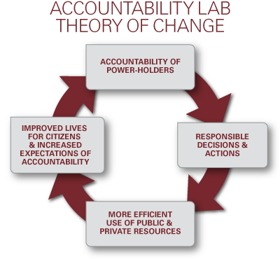
Accountability Lab
Notes:
The Lab supports the accountability of power-holders as this leads to more
responsible decisions and actions. The result, in turn, is more efficient use of
resources and improved lives for citizens.

Slide 16
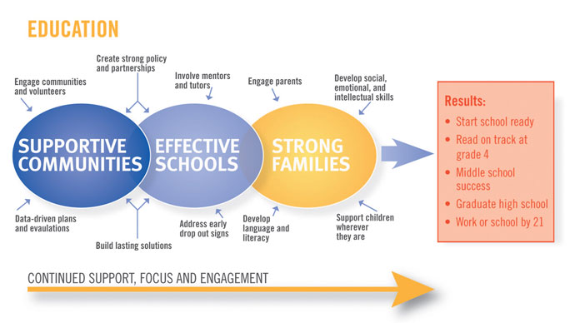
Involving Parents in their Child’s Education – Theory of Change

Slide 17
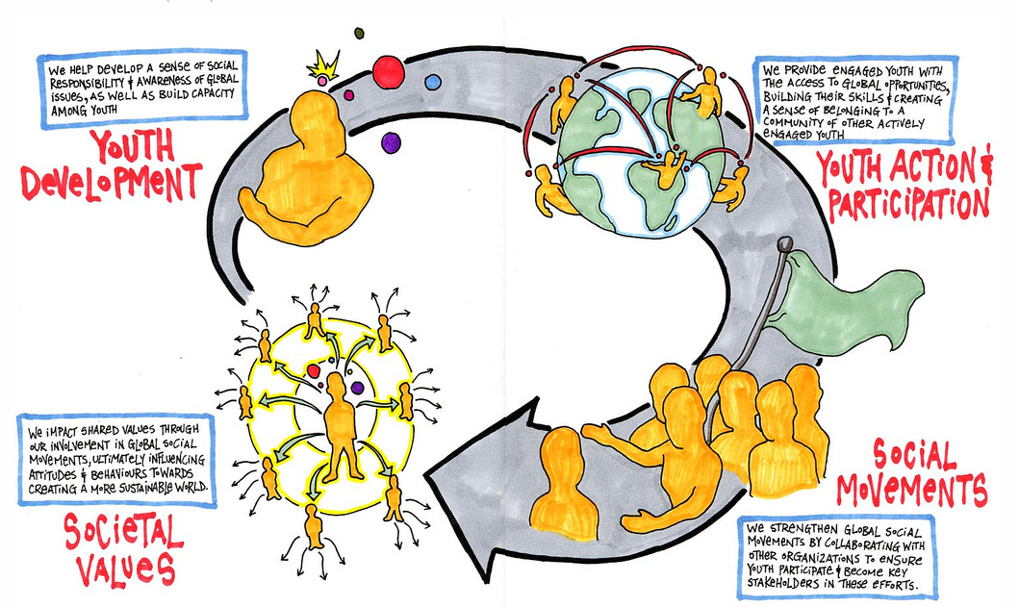
TIG Theory of Change 2010

Slide 18
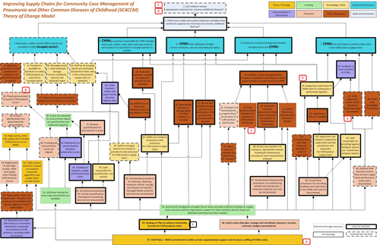
Improving Supply Chains for Community Care Management of Chronic Diseases

Slide 20
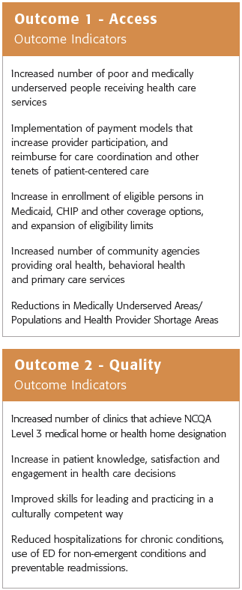
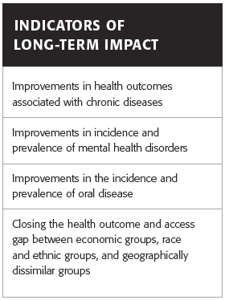
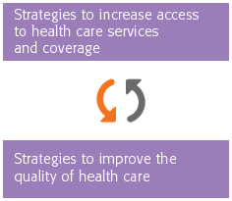
Indicators

Slide 21
Digging into the REACH Theory of Change
A deeper dive into the components of the Theory

Slide 22
Definitions
Reading the Theory of Change

Slide 23
Key Terms
Impact – The desired change in health outcomes in the target population
Outcome – The necessary theorized precursors to change in health outcomes – in the REACH TOC we believe that increasing access and improving the quality of services for our target population will lead to our desired impact
Indicator – Indicators tell us how success will be recognized. In the REACH TOC indicators represent a category of potential metrics
Metric – The specific behavior, condition, or status that will be measured – Metrics must be operational. By operational we mean that they include enough detail for us to be able to measure it

Slide 24
Digging In: Long-Term Impact
The desired change in health outcomes in the target population
What our investments are designed to accomplish
Two impacts we seek: improving health outcomes and achieving equity in outcomes, access and quality
Grantees asked to select one or more
Impacts may take years to accomplish - Incremental improvements are expected though

Slide 25
Measuring your Impact - Indicators
REACH asks grantees to select an indicator and describe one or more metrics to measure the impact of their project on patient health outcomes
The indicators in the TOC represent broad categories of specific metrics you could choose
Very often the metrics you choose are ones you are already using

Slide 26
Digging into Outcomes
Early or intermediate outcome – can be achieved within a few years
The measurable change in the health care provider organization and larger health care system – precursors to impact
Focus is on two outcomes: increasing access to high quality services or improving quality of the services delivered – must chose at least 1

Slide 27
Measuring your Outcomes - Indicators
REACH asks grantees to measure the change in the outcomes of their project in terms of patient access and/or the quality of services patients receive.
The indicators in the TOC represent broad categories of specific metrics – you must select at least 1 indicator and propose at least one metric
Very often the metrics you choose to measure are ones you are already using

Slide 28
Our focus so far – What you measure
as a condition of REACH grant
Outcomes Evaluation

Slide 29
Digging into Strategies
Strategies are what you have proposed to implement (and what we fund you to do)
Their presence in the TOC indicates that they have an evidence-base or are promising as a practice to bring about change in the outcomes
Two kinds of strategies: those that will increase access to care and those that will improve the quality of care received

Slide 30
Measuring Strategy Implementation
Strategies require execution – how well your organization executes the strategy is the focus of implementation evaluation
More extensive evaluations of specific strategies will have identified implementation benchmarks and quality thresholds or standards
REACH has not imposed a rigorous implementation evaluation requirement – instead, we ask that you document implementation by answering a series of key questions – Measures of Execution

Slide 31
Measures of Execution
1. Did you do what you said you would do? Any modifications?
2. What are your standards of quality and did you meet them?
3. Is project on pace to be successfully implemented?
4. Were the right patients recruited? (Screening Criteria)
5. Were your clients satisfied with the services received?
6. Did your partners/collaborators perform as expected?

Slide 32
Preparing the Evaluation Section of your Program Proposal
Looking at the Proposal Template for Program Grants

Slide 33
Your Plan to Measure Impact
Impact (from REACH Theory of Change): The impact this project will have on the patients served is: Improve health outcomes for uninsured and medically underserved people.
Indicator of Long-Term Impact | Sample | Metric | Baseline | Target Goal
1. Improvements in health outcomes associated with chronic diseases (please specify: hypertension) | 120 adult uninsured Hispanic males seen in clinic with other diagnoses and suspected hypertension | SBP/DBP | 10% have SBP < 140 mm Hg and/or DBP < 70 mm Hg | 90% will have SBP < 140 mm Hg or DBP < 90 mm Hg

Slide 34
Your Plan to Measure Outcomes
REACH Outcome (from REACH Theory of Change): The outcome of this project is: Improved quality of health care services
The REACH strategy this project will implement to achieve this outcome is: Care coordination and/or intensive case management/disease management (for hypertensive adult males).
Outcome Indicator | Sample and Metric | Baseline | Target Goal and Timeframe | Source of Data
1. Increase in patient knowledge, satisfaction and/or engagement in health care decisions | % of 120 adult uninsured Hispanic male participating in the care coordination project. Metric: patient knowledge, satisfaction and/or engagement in care decisions | 22% knowledgeable 18% satisfied 6% engaged | By the end of the grant term 90% will report feeling knowledgeable, satisfied, and engaged | Patient Satisfaction Survey administered at entry into the project and within 2 weeks of conclusion of the grant term

Slide 35
Evaluation of the REACH Theory of Change
How REACH evaluates our Investments

Slide 36
How REACH evaluates our Theory of Change
REACH requests and aggregates data from our grantees and partners on these measures of the components of the theory of change in order to:
Test the fidelity of the theory of change; and
track whether change in the inputs is indeed leading to change "downstream" in the outcomes and impacts.
Where investments in specific strategies fail to bring about threshold levels (meaningful) of change in outcomes after a sustained period of investment we ask ourselves six questions:

Slide 37
Questions REACH Asks When No Meaningful Change in Impact or Outcomes is Found
Is the organization implementing the strategy the right organization?
Was the selected strategy the right strategy to address the needs of the target population?
Was the strategy implemented with fidelity and consistency over sufficient time to allow for change to occur?

Slide 38
Questions REACH Asks When No Meaningful Change in Impact or Outcomes is Found
Were the size and duration of the investment sufficient to allow change in outcomes and impact to occur?
Were the processes used by the grantee to create the conditions and capacity necessary to implement the strategy successful?
Were the pre-existing conditions or influences in the organization, project, and/or community considered and addressed by the grantee such that negative influences were suppressed to allow for the potential effects of the strategy to be realized?

