Slide 1
2013 FULL PROPOSAL CONFERENCE Program and Core Operating Grants

Slide 2
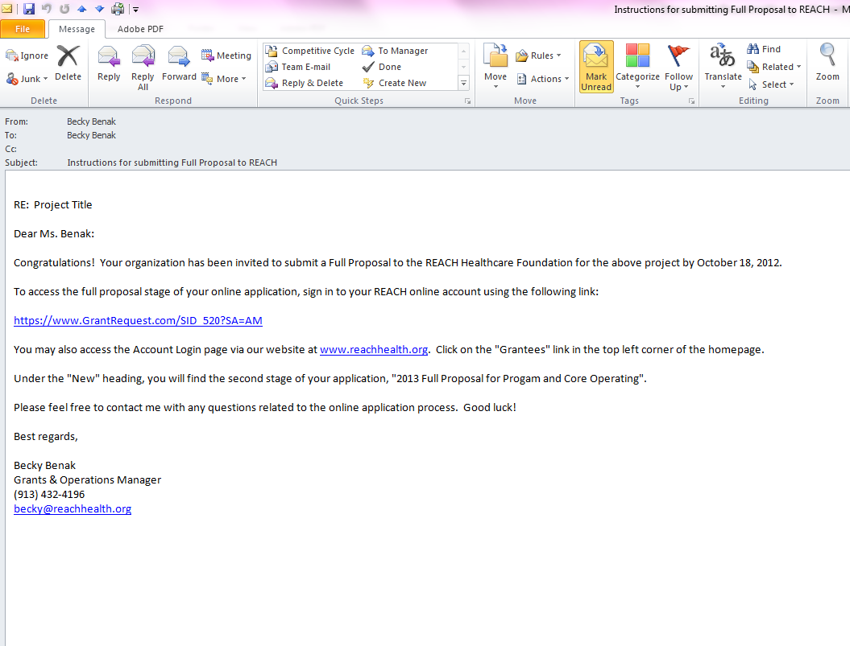

Slide 4
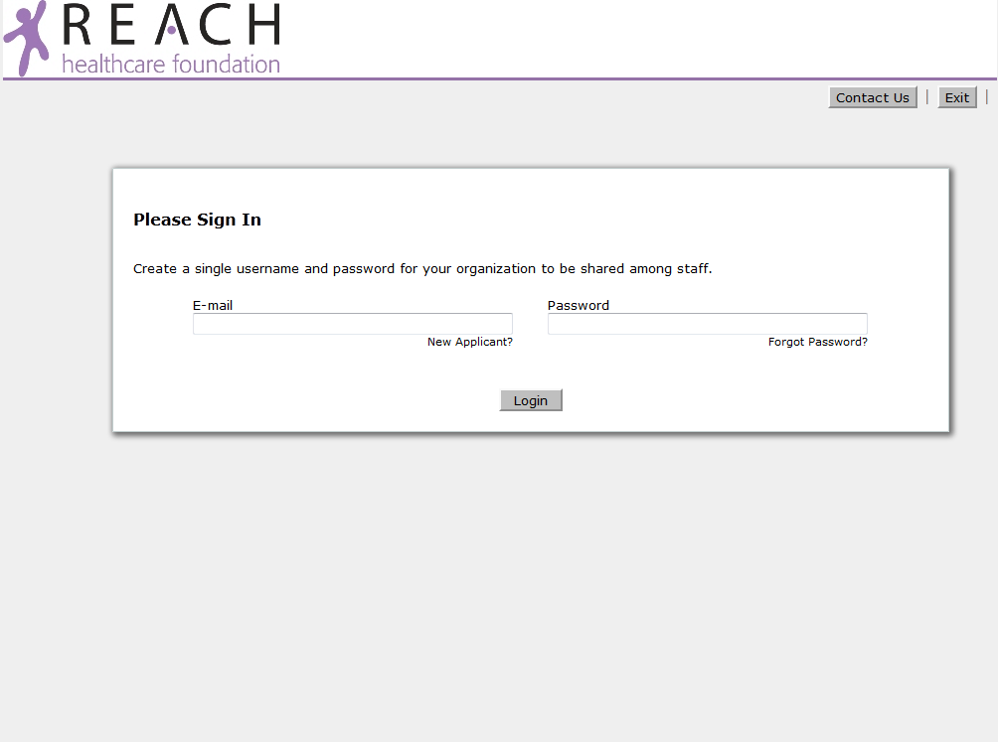

Slide 5
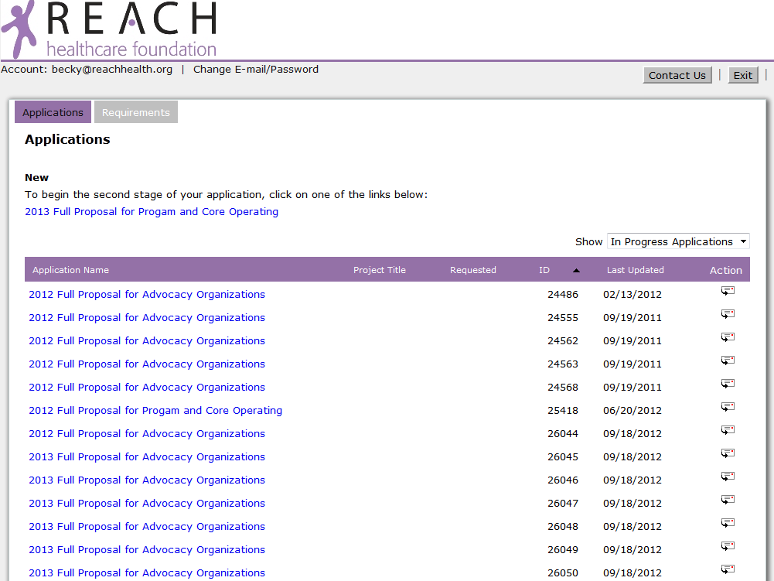

Slide 6
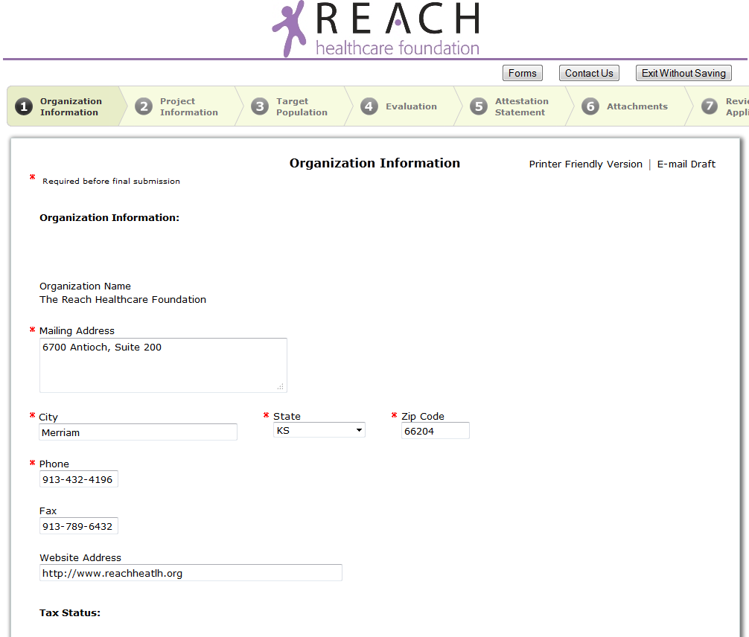

Slide 7
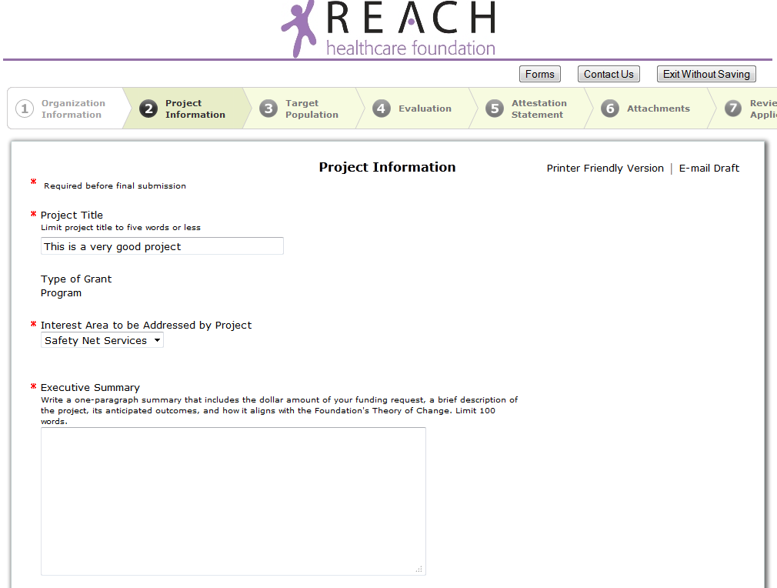

Slide 8
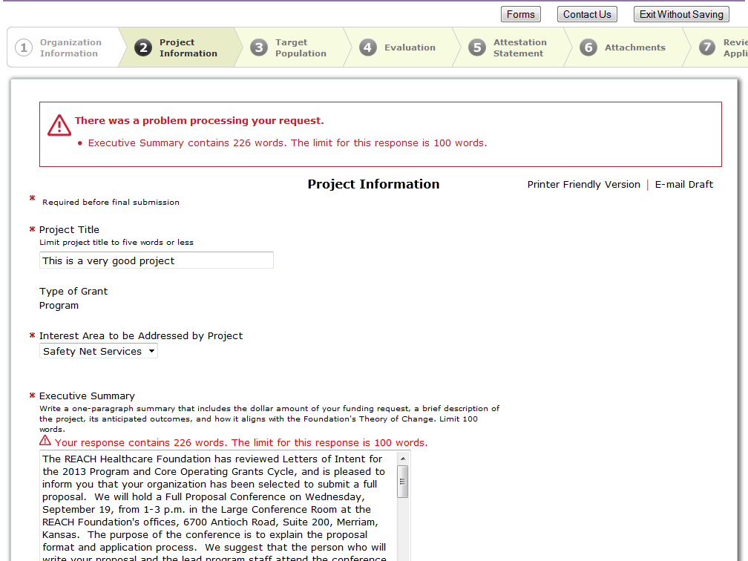

Slide 9
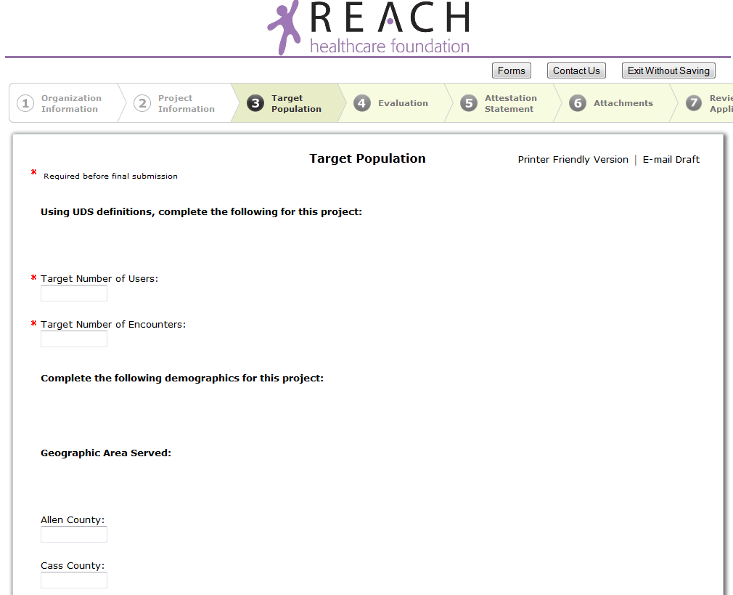

Slide 12
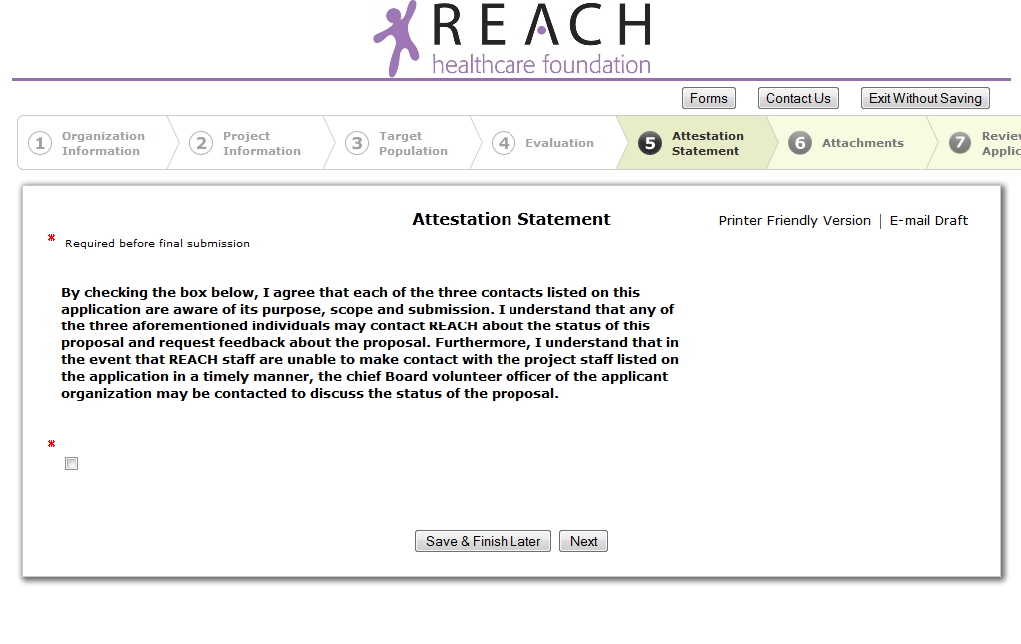

Slide 13
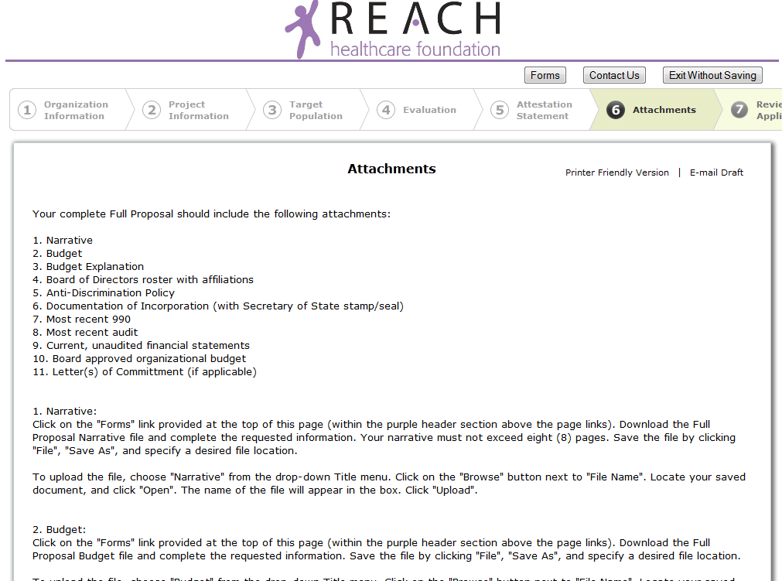

Slide 14
Anti-Discrimination Policy
The Foundation does not discriminate on the basis of race, color, religion, national origin, age, disability, sexual orientation or veteran status. Grantees are expected to have similar policies in their employment practices and provision of services. Applicant organizations must comply with local, state and federal regulations related to non-discrimination, wage and hour laws, workplace safety, licensure, protection of confidential health care information and all other laws and regulations applicable to the staff, patients and consumers.
http://reachhealth.org/grants/eligibility/

Slide 15
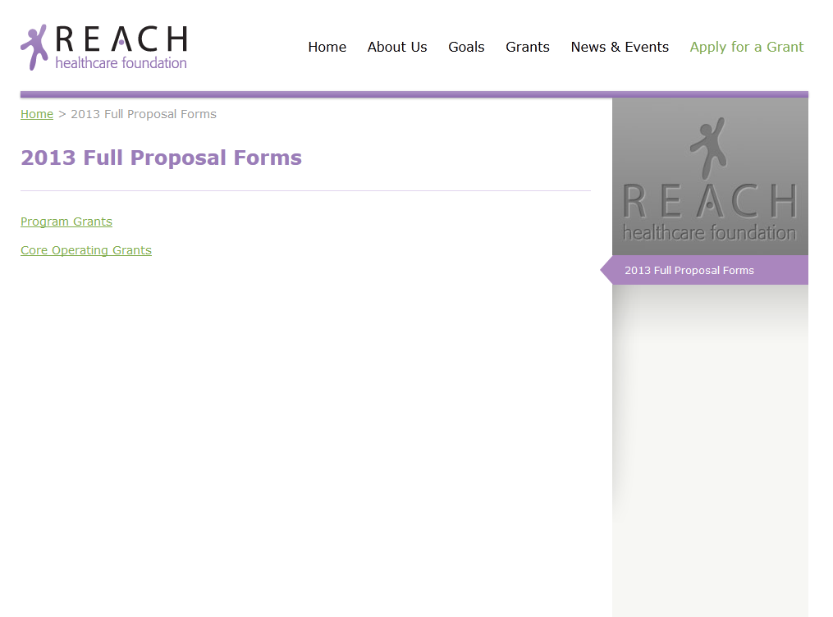

Slide 16
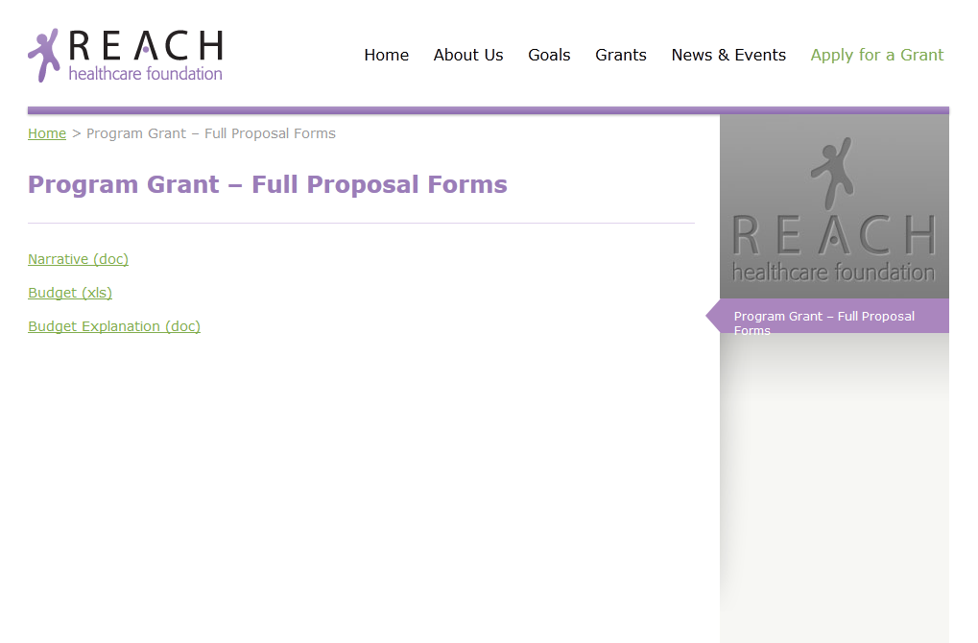

Slide 17
Attachments
For 501(c)(3) Organizations:
Proposal Narrative
Project Budget
Budget Explanation
Board Roster w/ Affiliations
Anti-Discrimination Policy
Letter(s) of Commitment (if applicable)
Documentation of Incorporation (with Secretary of State stamp/seal)
Most recent 990 Tax Return
Most recent Audit (with Management Letter)
Current, internal financial statements for period after audit
Current detailed board approved organization budget
For Governmental Entities:
Proposal Narrative
Project Budget
Budget Explanation
List of Elected Officials
Anti-Discrimination Policy
Letter(s) of Commitment (if applicable)
Enabling statute/legislation or statutory description of the entity’s responsibility or purpose
Most recent Audit (with Management Letter)
Current, internal financial statements for period after audit
Current detailed board approved organization budget
*Items below the line may be reviewed by staff if received
at least one week prior to deadline.

Slide 18
Timeline
Full Proposal Conference September 19
Proposal Deadline Thursday, October 18, by 4:00 pm
Notification of Core Operating Awards November 14
Notification of Program Grant Awards January 2, 2013
Grant Term Begins January 2013
Technical Assistance/Evaluation Workshop:
Wednesday, October 3, 10:00 a.m. – Noon
*REACH Large Conference Room.
*Space is limited. RSVP under “News & Events” on our website.

Slide 19
Application Assistance
Program staff available to provide feedback on Letter of Intent
Review FAQ’s on the website
Technical Assistance Workshop
Attachment review (received at least one week prior to deadline)*
Early Submission Guarantee (48 hours prior to deadline)*
Contact program staff or grants manager for help

